Slide 1

Artificial Intelligence and its applications
Exploring AI Technologies & Their Impact
By Alex Deng & Thor Birch

Slide 2
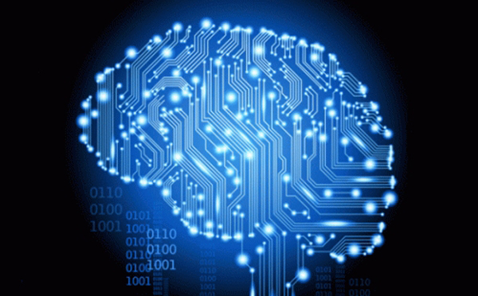
What is AI?
Artificial intelligence (AI) is the simulation of human intelligence processes by machines, especially computer systems. Essentially it involves computer programs to reason on the same model as a human brain, by focusing on three cognitive skills – reasoning, learning and self-correction.

Slide 3
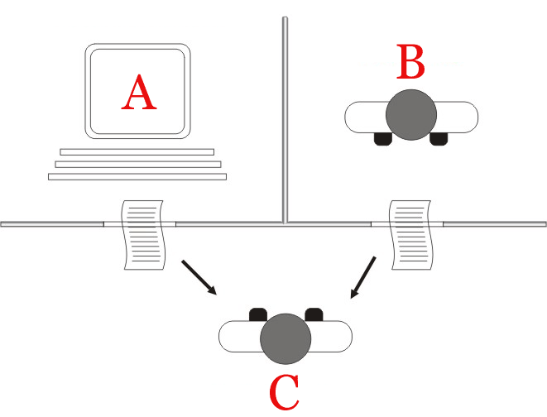
The prototype of AI
The Turing test, originally called the imitation game by Alan Turing in 1949, is a test of a machine's ability to exhibit intelligent behavior equivalent to that of a human. In the test, a human evaluator judges a text transcript of a natural-language conversation between a human and a machine.

Slide 4
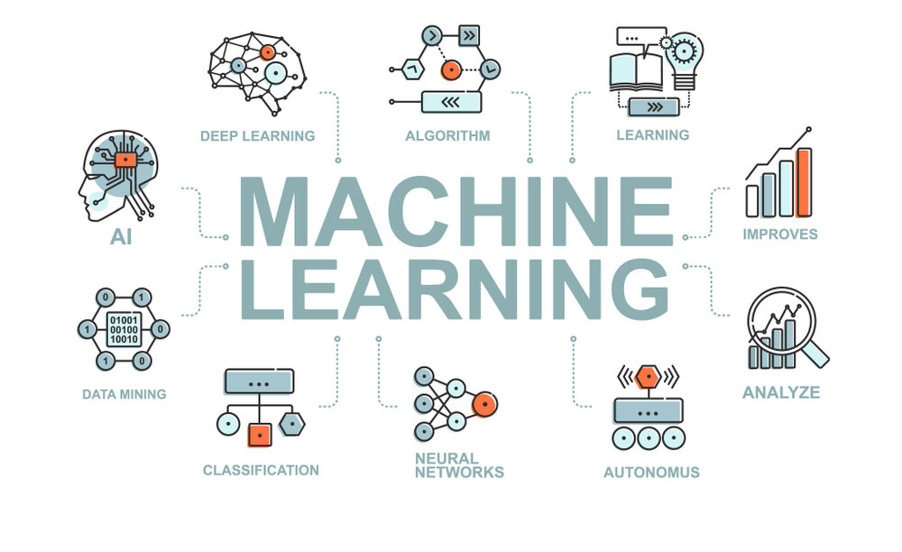
Key Technologies in AI
Machine learning is a field of study in artificial intelligence concerned with the development and study of statistical algorithms that can learn from data and generalize to unseen data and thus perform tasks without explicit instructions.
Deep learning is a type of machine learning that uses artificial neural networks to learn from data. Artificial neural networks are inspired by the human brain, and they can be used to solve a wide variety of problems, including image recognition, natural language processing, and speech recognition.

Slide 5
Applications of AI
AI in healthcare
Disease diagnosis: AI can be used to analyze patient data and discover patterns that may indicate disease. This helps doctors diagnose diseases earlier and more accurately.
Therapeutic development: By analyzing large datasets containing patient data, AI may discover new models and relationships that can be used to develop new drugs and therapies.
Personalized care: By analyzing a patient's data, AI can help doctors tailor treatment to the patient's specific needs.
AI in manufacturing
Increase efficiency: Automate tasks such as assembly and inspection Increase productivity: Optimize production processes Improve quality: AI can be used to detect defects and improve quality control

Slide 6
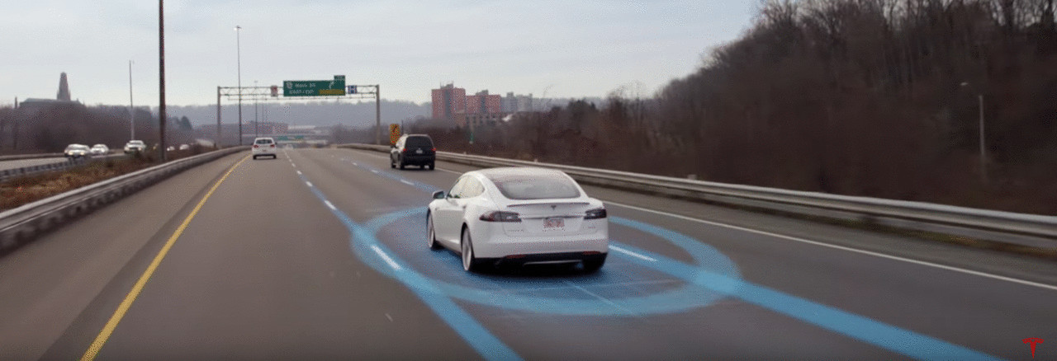
Case Studies and Examples
The history of autonomous driving systems (ADS) dates back nearly a hundred years. The early concepts of self-driving cars have evolved into today’s sophisticated ADS due to technological advancements. Significant developments in computing, artificial intelligence, and sensor technology have marked this evolution. Initially, the progress in ADS could have been faster, constrained by the limitations of early technology. However, the last few decades have seen a rapid transformation in this field, bringing us closer to the goal of fully autonomous vehicles.

Slide 7

Data Privacy & Security
The three pillars of information security
Confidentiality – prevents sensitive information from reaching the wrong people while making sure that the right people can use it;
Integrity – maintains the consistency, accuracy, and trustworthiness of information over its lifecycle;
Availability – ensures that the information is available when it is needed.

Slide 8
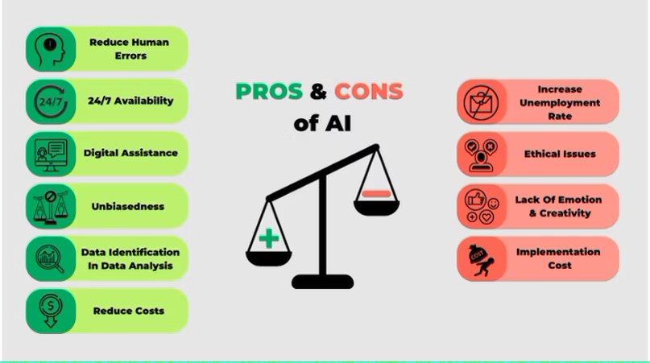
Benefits & Shortage of AI
Artificial intelligence provides numerous benefits such as reducing human errors, time saving capabilities, digital assistance, and unbiased decisions. However, the disadvantages include emotional intelligence, encouraging human laziness, and job displacement.

Slide 9
Future Scope
Future Trends: Human-AI collaboration, advanced AI systems, cross-disciplinary integration
Progress and even breakthroughs in AI have typically demonstrated that AI systems have the ability to perform at solving specific problems or tasks such as recognition, classification, ranking, prediction, clustering, segmentation, playing games, like Go/Jeopardy, and even creation of artwork, like music or paintings.

Slide 10
References:
Slide2:
https://www.opendatasoft.com/en/glossary/artificial-intelligence-ai/
https://www.cdstm.cn/theme/khsj/khzx/khcb/201704/t20170427_483884.html
Slide3:
https://en.wikipedia.org/wiki/Turing_test
Slide4:
https://en.wikipedia.org/wiki/Machine_learning
Slide5:
https://cloud.google.com/discover/ai-applications
Slide6:
https://www.linkedin.com/pulse/how-path-planning-works-self-driving-cars-david-silver
https://www.sciencedirect.com/science/article/pii/S0921889024000137
Slide7:
https://dataprivacymanager.net/security-vs-privacy/
Slide8:
https://www.simplilearn.com/advantages-and-disadvantages-of-artificial-intelligence-article
Slide9:
https://onlinelibrary.wiley.com/doi/10.1155/2021/8893795

